Slide 1



State of the Nation: ASEAN
Understanding ASEAN’s changing consumers
Join in the conversation
@asiacapable #ASEANinAus

Slide 2
Nicholas Henderson
Director
Asialink Business
Join in the conversation
@asiacapable #ASEANinAus

Slide 3
Ian Humphreys
Partner
Ashurst
Join in the conversation
@asiacapable #ASEANinAus

Slide 4
The Hon Steven Ciobo MP
Minister for Trade, Tourism & Investment
Australian Government
Join in the conversation
@asiacapable #ASEANinAus

Slide 5
Nicholas Henderson
Director
Asialink Business
Join in the conversation
@asiacapable #ASEANinAus

Slide 6
Professor Alice Woodhead
Professor Value Chains,
University of Southern Queensland
Board Member, Australia-ASEAN Council
Join in the conversation
@asiacapable #ASEANinAus

Slide 7
Australia-ASEAN Council
Established by the Minister for Foreign Affairs in 2015
Generates opportunities for Australian business, education, science, innovation and the arts to work with partners in Southeast Asia.
Programs
  an annual grants round for projects of between $20,000 and $40,000
  Australia-ASEAN BRIDGE program
  Australia-ASEAN Emerging Leaders Program
  projects to involve community in ASEAN-Australia Special Summit
For more information, visit www.dfat.gov.au/aac
Notes:
About the Australia-ASEAN Council
The Australia-ASEAN Council was established in 2015 by the Minister for Foreign Affairs, the Hon Julie Bishop MP.
We generate opportunities for Australian business, education, science, innovation and the arts to work with partners in Southeast Asia.
Our mission is to increase knowledge and promote Australia’s interests in the region by raising awareness, understanding and connections between people and institutions in Australia and Southeast Asia.
I am delighted to be an inaugural Board Member of the Australia-ASEAN Council and to be working with my fellow Board Members to foster bonds of friendship, understanding and opportunity between the people of Australia and Southeast Asia.
Programs
Annual Grants Rounds - to establish high quality projects with new partnerships between Australia and the countries of Southeast Asia. The 2018-19 round is now open and closes on 4 April. Information on the round and examples of the projects supported through previous rounds are available on the AAC website.
Australia-ASEAN BRIDGE Program - School partnerships with all nine countries (plus Australia-Indonesia BRIDGE) with classroom collaboration through 4 schools from each country with Australian schools. This is a teacher professional learning program that builds cultural knowledge and awareness, enhances IT skills through online links, establishes sustainable school partnerships, and builds a community of learners.
Australia-ASEAN Emerging Leaders Program – Supports young social entrepreneurs from Australia and Southeast Asia who are addressing critical challenges facing the region including the environment, agricultural production, education, health and ageing populations. Each year, one participant is drawn from each ASEAN nation and five from Australia. A2ELP 2018 participants are following a three-month program delivered by Asialink, that includes an intensive 10-day incubator in Melbourne and Sydney in March to explore the role of business in driving social change, enhance their understanding of the risks and potential of social ventures, and learn techniques to develop their enterprises and maximise their impact. To mark the ASEAN-Australia Special Summit, the 2018 cohort will join 2017 A2ELP alumni at events associated with the ASEAN-Australia Special Summit, including an Emerging Leaders Roundtable with the Prime Minister of Australia.
ASEAN-Australia Week Projects – The AAC is supporting seven projects to leverage the momentum of – and involve the community in – the ASEAN-Australia Special Summit. From academic conferences to youth forums, and cyber roundtables to support for Southeast Asian artists to participate in the 21st Sydney Biennale. The diversity of projects reflects the many connections between the people of Australia and Southeast Asia.

Slide 8
Nicholas Henderson
Director
Asialink Business
Join in the conversation
@asiacapable #ASEANinAus

Slide 9
Peter Hennessy
Director
Jeta Global
Join in the conversation
@asiacapable #ASEANinAus

Slide 10


STATE OF THE NATION
BRISBANE & TOWNSVILLE
07 MARCH 2018

Slide 11
A MARKETPLACE OF 635,000,000

Slide 12
AN UNFOLDING ECONOMIC AND SOCIAL CRISIS
AN UNPRECEDENTED AGEING DYNAMIC!!

Slide 13

THE ASEAN AGEING MARKETS
1
5
4
3
2

Slide 14

RECOGNISE THE SOCIAL CHALLENGES

Slide 15
RECOGNISE THE SOCIAL CHALLENGES

Slide 16
RECOGNISE THE SOCIAL CHALLENGES

Slide 17

THE LEGISLATIVE AND
ECONOMIC CHALLENGES
No or minimal Regulatory Environment (Except Singapore)
Most countries adopt clinical rather than lifestyle bias (Adaption of hospital Regulations)
“Bricks and Mortar” rather than Services (Developers eye Aged Care “Windfall”)
Little attention to socially and economically disadvantaged
Immature or no Pension or Superannuation Plans
Artificially young retirement age embedded in Workplace legislation and work practices
Deficit of accredited aged care operators

Slide 18
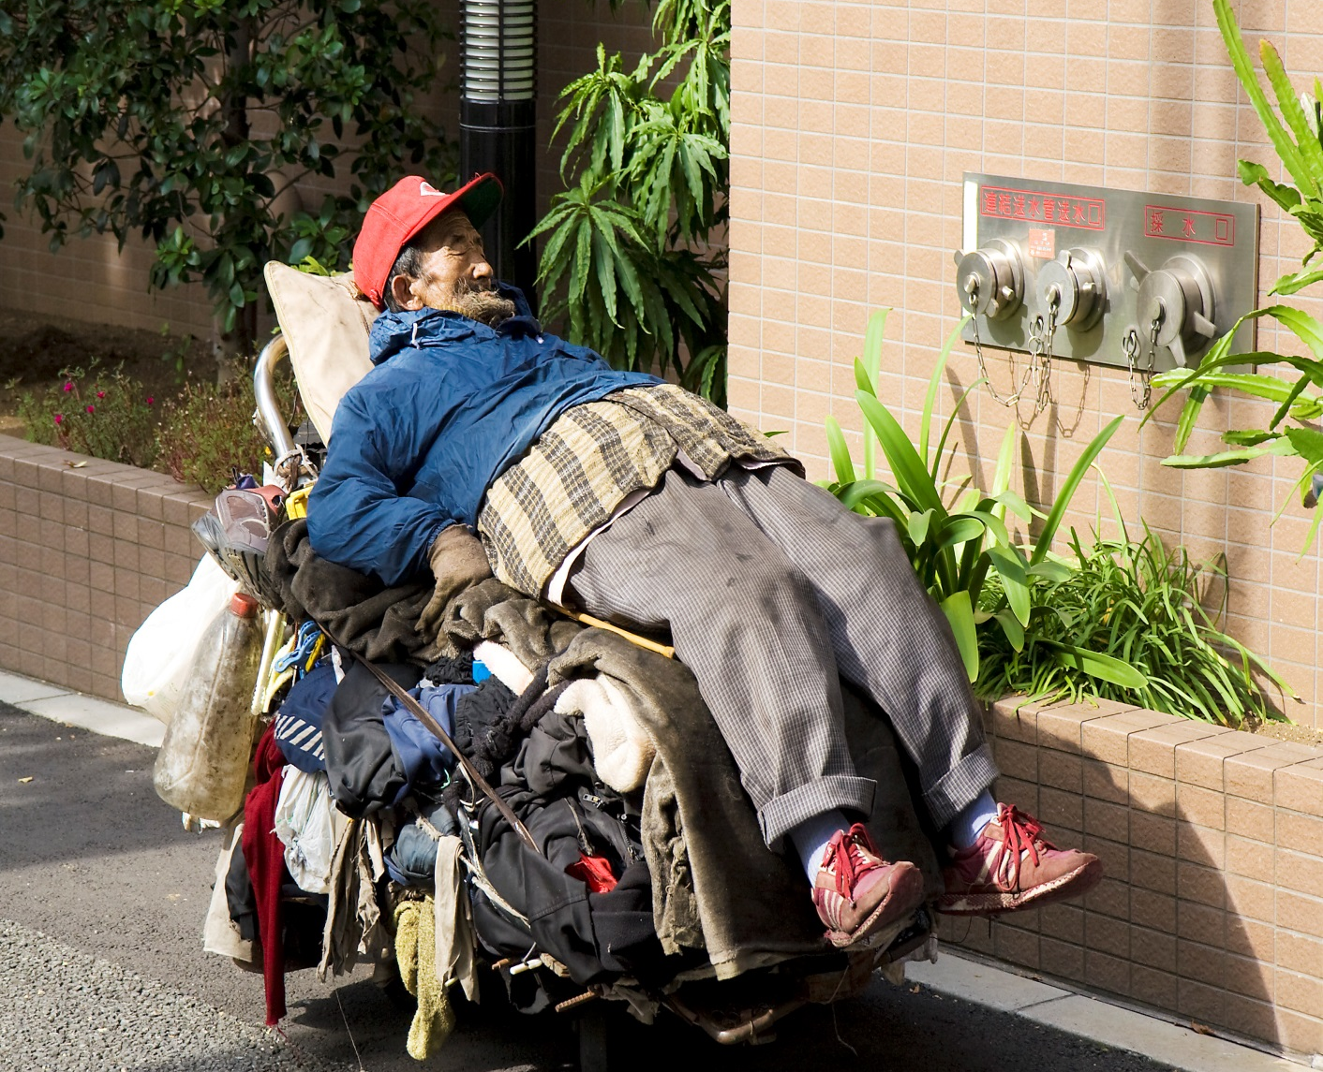
THE LEGISLATIVE AND
ECONOMIC CHALLENGES
UNLIKE THE WEST
MOST OF SOUTH EAST ASIA
IS BECOMING OLD
BEFORE BECOMING PROSPEROUS
This Photo by Unknown Author is licensed under CC BY-SA

Slide 19
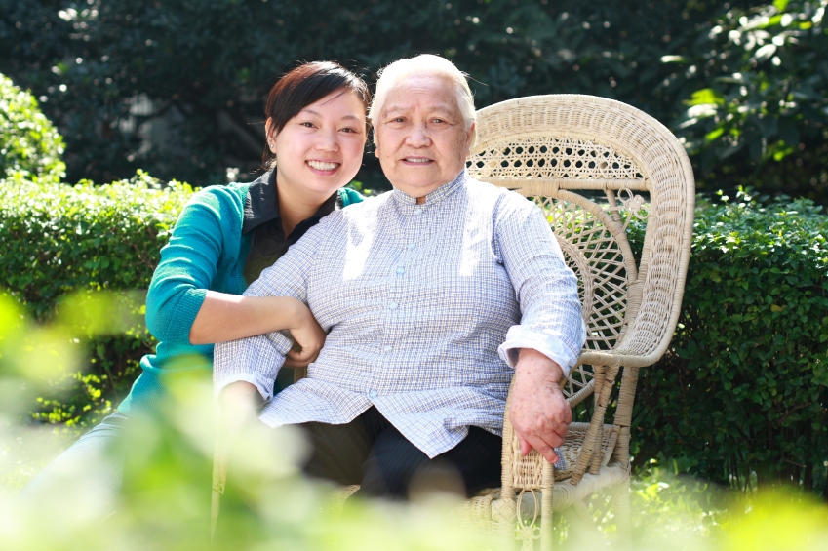
PREFERRED CARE MODEL
HOME CARE BASIS
PLUS
COMMUNITY CARE SUPPORT
WITH
RESIDENTIAL CARE AS A SUPPLEMENT
This Photo by Unknown Author is licensed under CC BY-SA

Slide 20
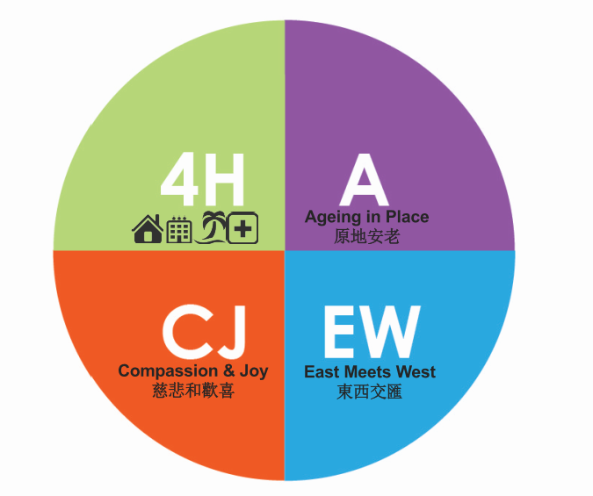


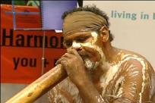
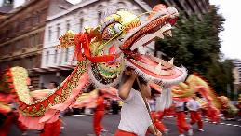
JETA RESPONSE - THE SOCIAL CHALLENGES
JETA 4H®

Slide 21
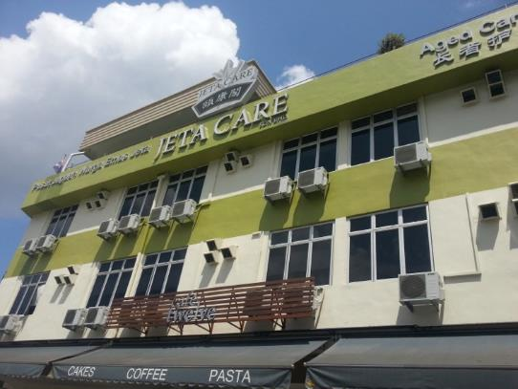
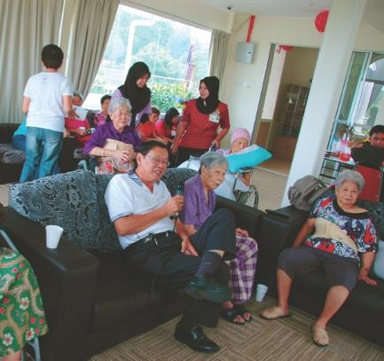
JETA ACHIEVEMENTS 颐康成就
“Jeta Care” - Kulai Jaya, Johor State Malaysia
马来西亚柔佛州古来“颐康阁”
80 BED AGED CARE FACILITY – 80个床位长者护理
Converted Shopping Precinct 由购物区转换到位

Slide 22
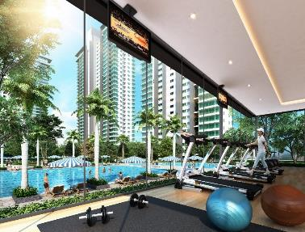
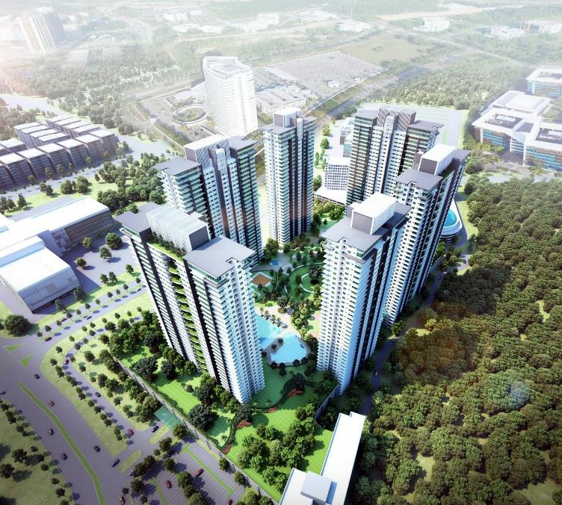
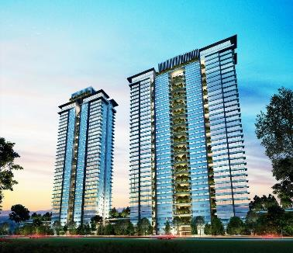
JETA ACHIEVEMENTS 颐康成就
“Dream Homes ” - Cyberjaya, Selangor State Malaysia
马来西亚雪兰莪州赛城 “梦家园”
MIXED DEVELOPMENT 混合型开发项目
• 200 BEDS ACF • 250 UNITS RETIREMENT APARTMENTS • 1800 UNITS APARTMENTS
TRAINING COLLEGE/ VIRTUAL UNIVERSITY/ COMMERCIAL / OFFICES ETC
200个长者护理床位 • 250间退休公寓 • 1800间高级公寓
培训学院/ 虚拟大学/商务区 /写字楼等

Slide 23
JETA ACHIEVEMENTS 颐康成就
Puteri Harbour, Johor State Malaysia
马来西亚柔佛州公主港
MIXED DEVELOPMENT 混合型开发项目
100 BEDS ACF • MEDICAL SUITES • ACTIVE AND SUPPORTED LIVING APARTMENTS • INTERGENERATIONAL APARTMENTS / COMMERCIAL / OFFICES ETC
• 100个长者护理床位•医疗套房• 独立和协助公寓 • 除代公寓/商务区 /写字楼等

Slide 24
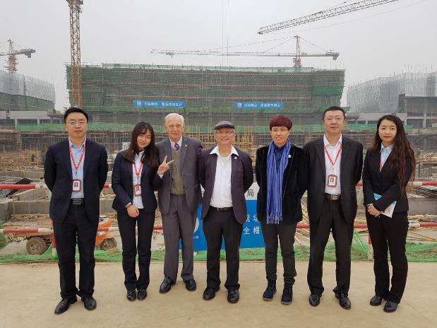
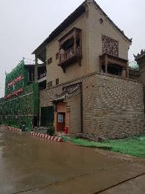
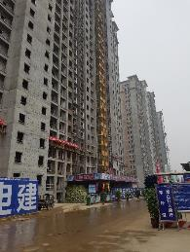
JETA ACHIEVEMENTS 颐康成就
“HWT” – Hanzhong, Shanxi Province PRC
中国陕西省汉中市“汉文投”
MIXED DEVELOPMENT 混合型开发项目
516 BEDS ACF • MEDICAL SUITES • ACTIVE AND SUPPORTED LIVING APARTMENTS • INTERGENERATIONAL APARTMENTS / COMMERCIAL / OFFICES ETC
• 516个长者护理床位•医疗套房• 独立和协助公寓 • 除代公寓/商务区 /写字楼等

Slide 25
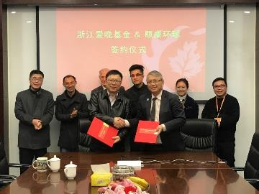
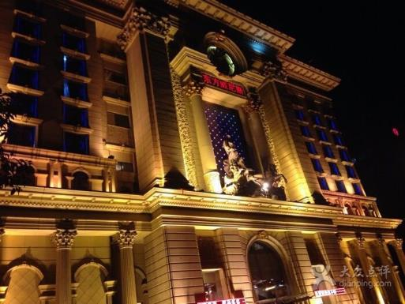
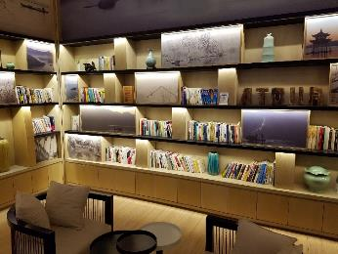
JETA ACHIEVEMENTS 颐康成就
“Zhejiang Aiwan Fund JV” – Hangzhou, Zhejiang Province PRC
中国浙江省杭州市“爱晚基金”
MIXED DEVELOPMENT 混合型开发项目
CONVERSION OF HOTEL INTO 300 PLACE ACF • DESIGN & DEVELOP MIXED DEVELOPMENT
ACF / RETIREMENT VILLAGE / COMMERCIAL RECREATIONAL
酒店到位转换300个护理床位 • 设计与开发混合型发展
护理床位 / 退休单位/ 商业娱乐

Slide 27
Nicholas Henderson
Director
Asialink Business
Join in the conversation
@asiacapable #ASEANinAus

Slide 28
Jim Parashos
Head of Aviation Business Development
Brisbane Airport
Join in the conversation
@asiacapable #ASEANinAus

Slide 29
Nicholas Henderson
Director
Asialink Business
Join in the conversation
@asiacapable #ASEANinAus

Slide 30
Q&A with panel
Professor Alice Woodhead, Professor Value Chains at University of Southern Queensland, Board Member at Australia-ASEAN Council
Peter Hennessy, Director, Jeta Global
Jim Parashos, Head of Aviation Business Development, Brisbane Airport
Facilitated by
Nicholas Henderson Director, Asialink Business
Join in the conversation
@asiacapable #ASEANinAus

Slide 31
Nicholas Henderson
Director
Asialink Business
Join in the conversation
@asiacapable #ASEANinAus

Slide 32










ASEAN COUNTRY STARTER PACKS
PRACTICAL GUIDES FOR AUSTRALIAN BUSINESSES

Slide 33
State of the Nation: ASEAN
Understanding ASEAN’s changing consumers
Join in the conversation
@asiacapable #ASEANinAus

